Slide 1
download
R
hypoth testing example.R
aldenderfer burial.dat
aldenderfer burial work.R
mandara knife cluster examples.R
knife data.dat
NB: check for library “cluster”

Slide 2
multivariate EDA: distance & similarity approaches
0.00 100.00
Case 6 -----------------------\
+-----------------------\
Case 8 --------------------\ | |
+--/ |
Case 4 --------------------/ |
+---------\
Case 9 --------------------\ | |
+------------\ | |
Case 2 --------------------/ | | |
+-------------/ |
Case 1 ---------------------------------/ |
|-------
Case 10 ---------------------------\ |
+-----------------------------/
Case 5 --------------\ |
+------\ |
Case 3 --------------/ | |
+-----/
Case 7 ---------------------/

Slide 3
multivariate analysis
examination of multiple variables
  e.g., multiple regression
somewhat restrictive model
  one variable is dependent
    arbitrary?
    multiple analyses to sort out more complex relationships…

Slide 4
other multivariate methods don’t make this distinction
several are based on the use of distance or similarity measures
basic task:
  convert a rectangular matrix of observations to a square matrix that reflects levels of similarity or difference
    usually amongst cases

Slide 5
 | V1 | V2 | V3 | V4
C1
C2
C3
V1
V2
V3
V4
C3
C2
C1
“r-mode analysis”
 | C1 | C2 | C3
C1
C2
C3
 | V1 | V2 | V3 | V4
V1
V2
V3
V4
“similarity/distance”

Slide 6
basic ideas (about distance)
greater distance = greater difference
greater similarity = less difference
distance usually unbounded
  0 - ∞
similarity usually between 0-1
  1 = identical entities
  0 = as different as possible
symmetric:
  S(ab)=S(ba); D(ab)=D(ba)

Slide 7
distance vs. similarity
difference is trivial
can easily convert one to the other:
0 <= S <= 1 D = 1 - S
0 <= D <= n S = n - D

Slide 8
 | A | B | C | D
A |  | .5 | .3 | .2
B | .5 |  | .6 | .1
C | .3 | .6 |  | .4
D | .2 | .1 | .4
A
B | .5
C | .3 | .6
D | .2 | .1 | .4
“lower triangular matrix” format

Slide 9
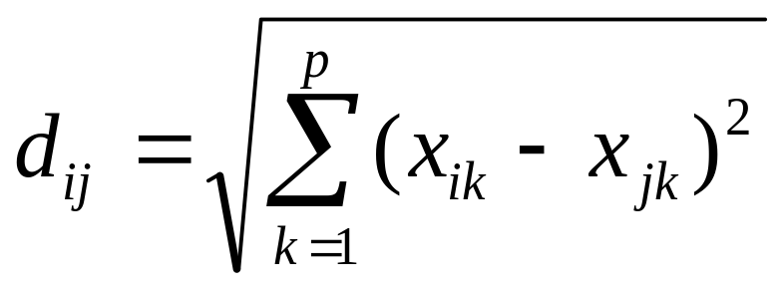
interval (or higher) data
Euclidean distance:
  straight line distance between two points in multivariate space:
  k = variable; i and j are the two cases being compared

Slide 10

edge-angle contribution is huge…
  consider Z-scores!
can calc. for presence/absence data
  i.e., on a scale of 0 & 1

Slide 11
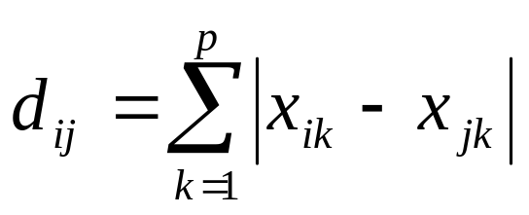
City Block (Manhattan) distance:
  like ED, but simply add up absolute differences for each variable
  distances between points are analogous (in two dimensions) to the route you would follow in a city

Slide 12
presence – absence data
 | V1 | V2 | V3
C1 | - | - | +
C2 | - | - | -
C3 | - | + | +
C1
 | + | -
+ | 1 | 1
- |  | 1
C3
positive match
negative match
mismatch

Slide 13
case 1
 | + | -
+ | 1 | 1
- |  | 1
a | b
c | d
case 3
simple matching coefficient (SMC)
  similarity coefficient
  S = (a+d)/(a+b+c+d)
  S = .66
  range: 0 - 1 (1 = maximum similarity)

Slide 14
case 1
 | + | -
+ | 1 | 1
- |  | 1
a | b
c | d
case 3
Jaccard coefficient
  similarity coefficient
  S = a/(a+b+c)
  S = .5
  range: 0 - 1 (1 = maximum similarity)

Slide 15
 | V1 | V2 | V3
C1 | - | - | +
C2 | - | - | -
C3 | - | + | +
simple matching
coefficient
Jaccard coefficient
 | C1 | C2 | C3
C1
C2 | .66
C3 | .66 | .33
 | C1 | C2 | C3
C1
C2 | 0.0
C3 | 0.5 | 0.0

Slide 16
DISTANCE
C1
C1
C2
C3
C3
C2
 | C1 | C2 | C3
C1
C2 | .33
C3 | .33 | .66
 | C1 | C2 | C3
C1
C2 | 1.0
C3 | 0.5 | 1.0
simple matching
coefficient
Jaccard
coefficient

Slide 17
which is better?
calculate both…
  pick examples of high, medium and low coefficients
  compare to matching values in the raw data
  which best reflects your ideas about what similarity ought to mean?
is “negative match” a useful measure of difference?
more than one D/S measure may give useful results…

Slide 18
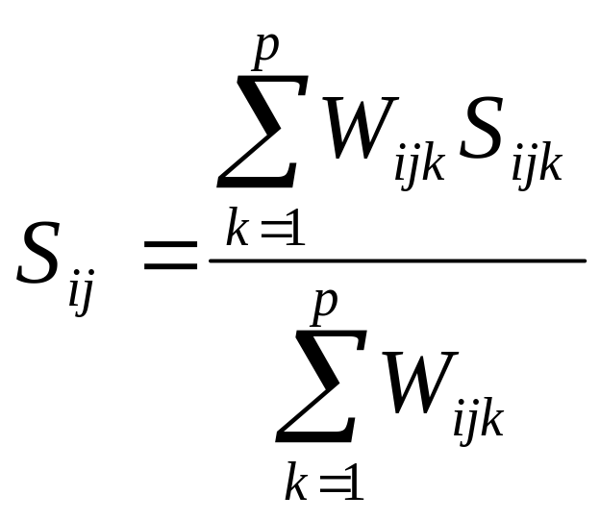
measures for nominal data
Gower’s Coefficient of Similarity:
  combines obs. on different scales
    +/-, nominal, interval, ratio…
  # of matches / # of valid comparisons:

Slide 19
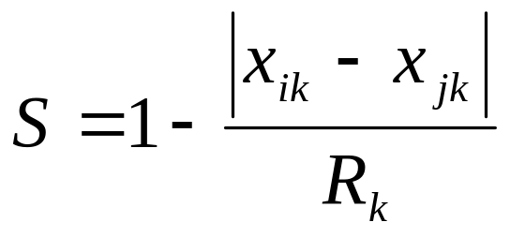
values of S
 | 1 | 0
+ / - | pos. match | mismatch
 | (neg. match) | (neg. match)
nominal | match | mismatch
interval

Slide 20





Slide 21
classification
different methods for different purposes
sometimes we want classes that are well separated from one another
  “external isolation and internal cohesion”
  “cleave nature at its joints” (Plato)
other classes may be more arbitrary
  “dissection” / “partition”

Slide 22
useful terms
monothetic type:
  based on a list of necessary and sufficient conditions for membership
  members exhibit a minimum set of criteria
  may be achieved by following a hierarchical ‘decision tree’
temper (2)
form (3)
slip (+/-)
a
b
c
d
e

Slide 23
polythetic type:
  class members share similar scores on a high percentage of criteria
  membership in a given class does not ensure that any specific criterion will be exhibited by a specific case
= kinds of types created by cluster analysis

Slide 24
cluster analysis
a whole family of methods
  classify cases = q-mode analysis
  classify variables = r-mode analysis
useful heuristic approach
  few assumptions; good for exploring data
  some approaches fit well with intuitive ideas about clustering—some do not

Slide 25
distance
need to be able to evaluate similarities between objects, objects and groups, and between groups and groups
  euclidean distance most common
  distance between individual cases (objects)
    straight-forward
  between groups and objects/groups
    various procedures…

Slide 26
basic points
cluster analysis generally weights variables approximately in proportion to their variance
variables with large variance have a big effect on the outcome of the clustering
  rare observations are likely to have less effect
  percent data: may put variables onto more even scales
  may want to do more to even out variance…

Slide 27
general approaches
agglomerative vs. divisive/partitioning
  adding vs. splitting cases
hierarchical vs. non-hierarchical
  if cases are in the same cluster in a 3-cluster solution, are they automatically members of the same cluster in a 2-cluster solution?

Slide 28
hierarchical agglomerative
based on a D/S matrix
each case = a single group
  start merging them into (larger) groups
  merge together the most similar pair in the matrix
  rebuild the similarity/distance matrix to reflect the new relationships among cases/groups
repeat until you have only one group…

Slide 29
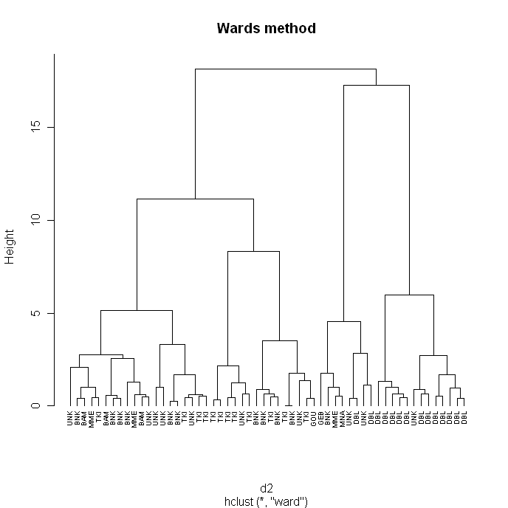
V1
V2
V3
V4
C3
C4
C2
C1
C1 C2 C3
C1
C2 | .5
C3 | .3 | .6
C4 | .2 | .1 | .4

Slide 30
merging rules
various rules for determining similarity between groups
have major effects on the outcome of the clustering…

Slide 31
single linkage
similarity/distance judged on the basis of the most similar pair of entities
a ‘nearest neighbour’ approach

Slide 32
[single linkage]
generally not very satisfactory
→ “chaining”

Slide 33
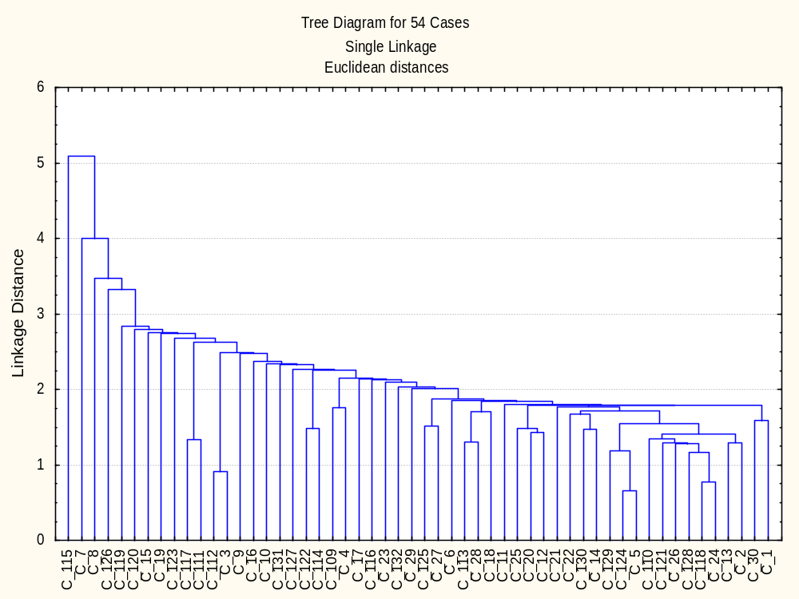

Slide 34
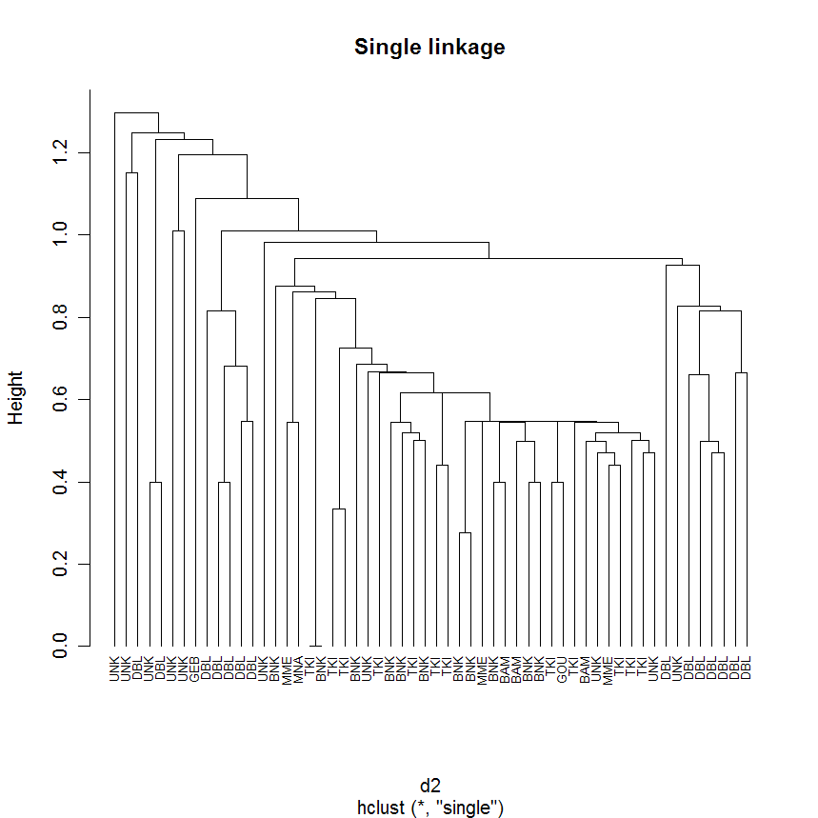

Slide 35
complete linkage
similarity/distance judged on the basis of the most dissimilar pair of entities
  logically opposite to single linkage
tends to create compact clusters of highly similar cases

Slide 36
[complete linkage]
can be useful, but favours large numbers of clusters with small numbers of members

Slide 37
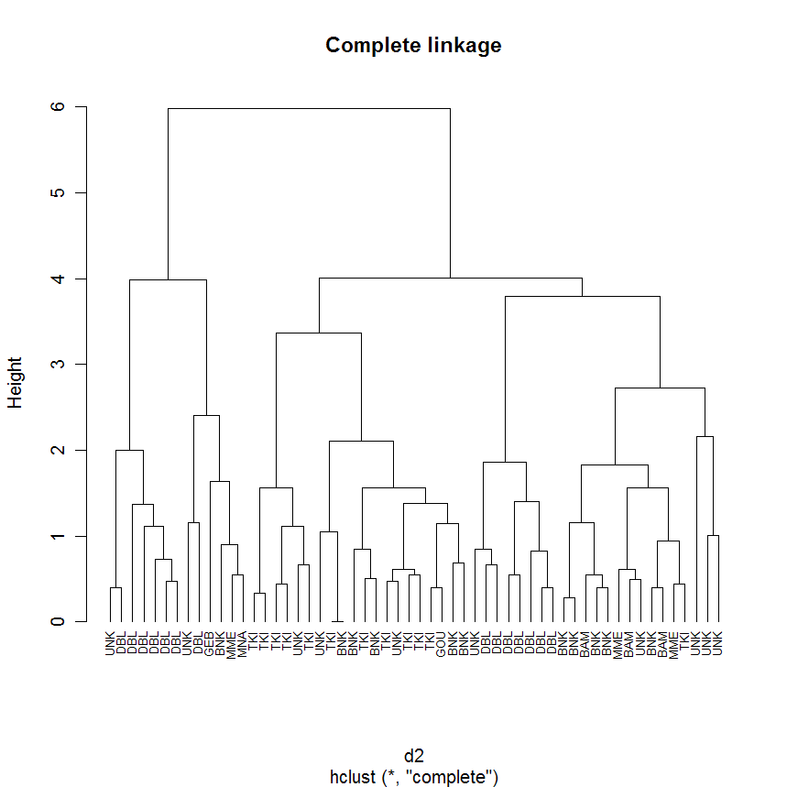

Slide 38
average linkage
based on mean of similarity measures calculated between all pairs of cases in both groups
  - sum all similarity coeff., divide by n1*n2
generally good, intuitive results

Slide 39
[average linkage]

Slide 40
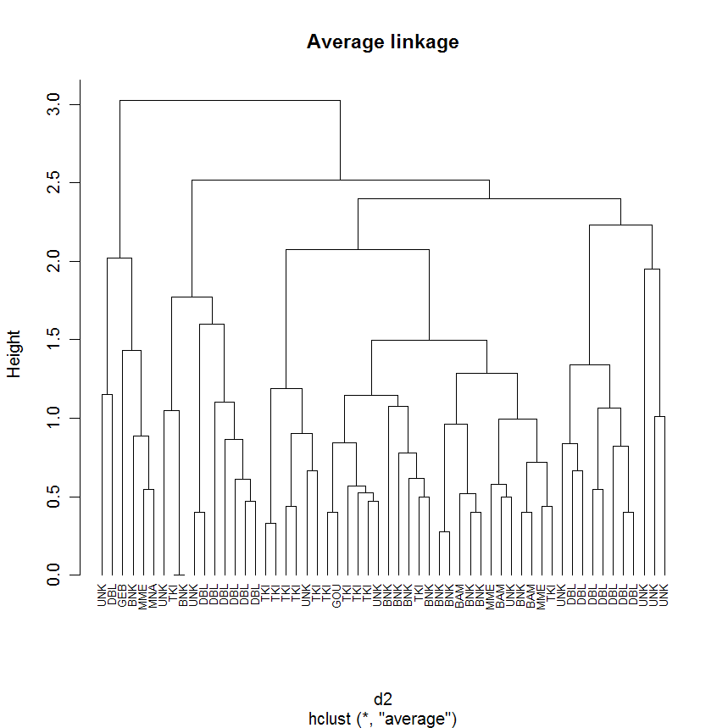

Slide 41
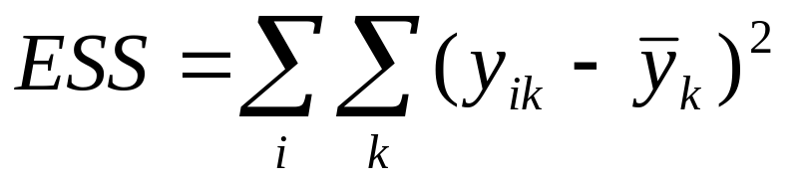

Ward’s method
clusters are compact & homogenous
joins minimize within-group sum-of-squares (ESS)
  within each cluster, ESS = squared deviation around the group mean (centroid)
    before any clustering, ESS = 0
    ESS increases with each join…
k = variables
i = clusters
= mean of kth var in cluster

Slide 42
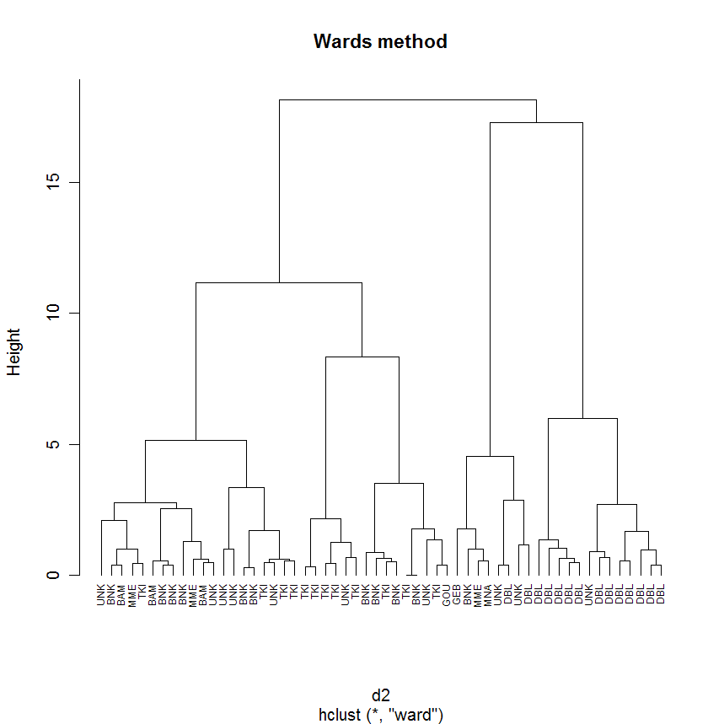

Slide 43
Ward’s method
main drawback: strongly influenced by elevational differences, rather than profile differences…
V1
V2
V3
V4

Slide 44
non-hierarchical divisive
iterative methods that produce a single cluster solution
k-means cluster analysis:
  partition data → k clusters
  calculate cluster centroids
  for each case, identify closest cluster centroid
    after a full pass, reassign cases to clusters
    recalculate cluster centroids
  repeat until all cases have been assigned to the cluster with the nearest centroid

Slide 45
k-means clustering (cont…)
the number of clusters is specified by the user
initial partitioning of the data can affect cluster solutions
options:
  random partition
  a user-supplied partition (perhaps based on a hierarchical cluster solution)
    may be based on “seed” centroids

Slide 46
R
Mark Aldenderfer’s burial data
Ian Robertson’s Mandara knife data

Slide 47
k-means clustering (cont…)
biased toward compact, hyperspherical clusters
solutions are not necessarily unique…
“unlucky” initial partitions may or may not be overcome…
may be trapped by “locally optimal” solutions, and miss “globally optimal” solutions

Slide 48
cluster evaluation
cluster analysis can produce different results depending on exact procedures, and the number of clusters analyzed
can generate clusters in random data

Slide 49
number of clusters?
k-means: a specific cluster solution is requested
hierarchical methods: the user has to decide where to ‘cut’ the dendrogram…
0.00 100.00
Case 6 -----------------------\
+-----------------------\
Case 8 --------------------\ | |
+--/ |
Case 4 --------------------/ |
+---------\
Case 9 --------------------\ | |
+------------\ | |
Case 2 --------------------/ | | |
+-------------/ |
Case 1 ---------------------------------/ |
|-------
Case 10 ---------------------------\ |
+-----------------------------/
Case 5 --------------\ |
+------\ |
Case 3 --------------/ | |
+-----/
Case 7 ---------------------/

Slide 50
number of clusters
if n = total number of cases, the choices range between 1 and n

Slide 51
n clusters
maximizes internal homogeneity
  clusters become effective “labels” for internal variation
costs:
  simplification that comes with smaller numbers of clusters
  insights into possible clustering behaviour

Slide 52
single cluster
the opposite extreme:
  maximum simplification
  minimum internal homogeneity

Slide 53
we want to find a useful middle ground
rarely interested in > n/2 clusters
  little simplification in such a high cluster-to-case ratio
research interests/questions may be the most important guide
evidence for ‘natural clustering’ can also be important

Slide 54
natural clusters are distinct clusters…
dendrograms can provide empirical evidence for this
“scree-plots” based on fusion coefficients…
0.00 100.00
Case 6 -----------------------\
+-----------------------\
Case 8 --------------------\ | |
+--/ |
Case 4 --------------------/ |
+---------\
Case 9 --------------------\ | |
+------------\ | |
Case 2 --------------------/ | | |
+-------------/ |
Case 1 ---------------------------------/ |
|-------
Case 10 ---------------------------\ |
+-----------------------------/
Case 5 --------------\ |
+------\ |
Case 3 --------------/ | |
+-----/
Case 7 ---------------------/

Slide 55
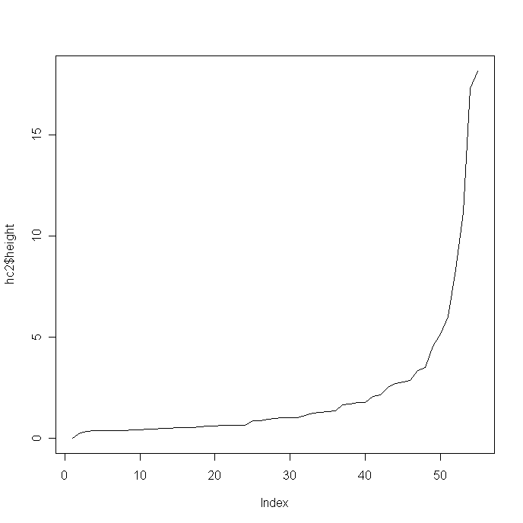

Slide 56
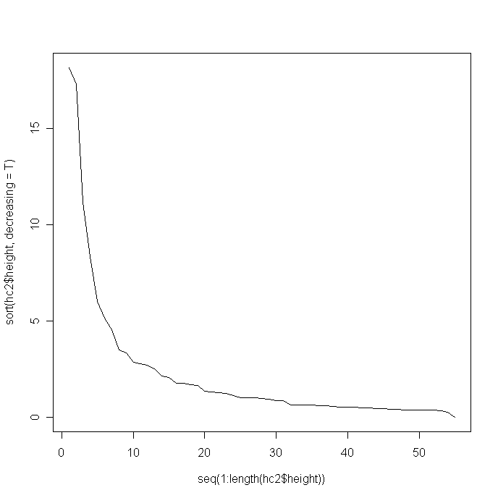

Slide 57
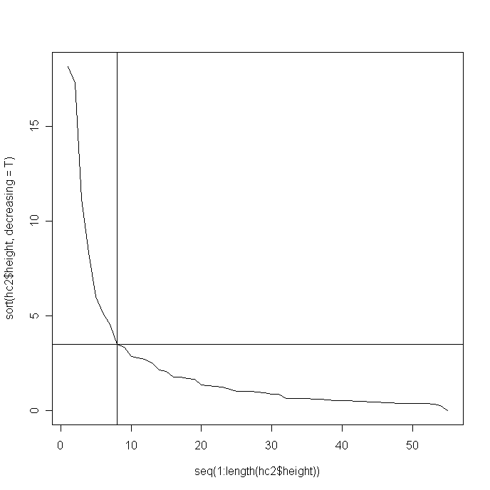

Slide 58
7
4
5
9
2
8
3
6

Slide 59
cluster content
what are the characteristics of the clusters?
which variables are most important?
boxplots for each variable, broken down by cluster
Discriminant Function Analysis
  input=cluster membership, and variables used in clustering
  output=an equation maximizing discrimination of cases by cluster membership

